Slide 1
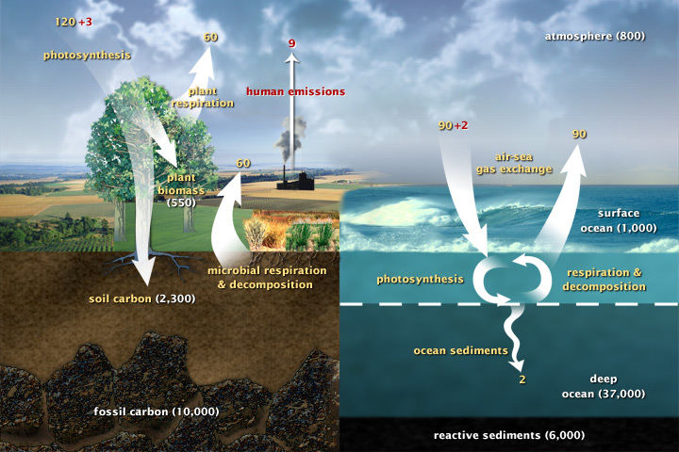
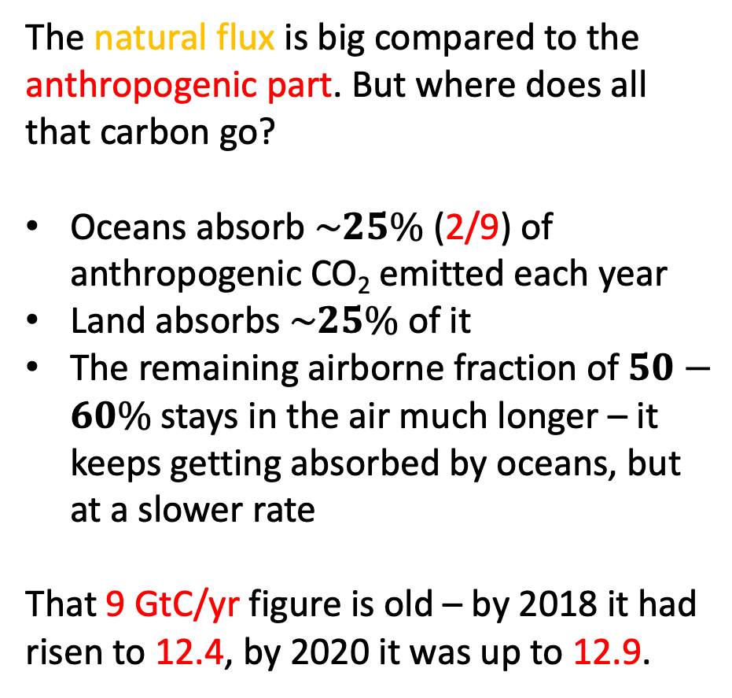
The fate of anthropogenic atmospheric carbon
The natural flux is big compared to the anthropogenic part. But where does all that carbon go?
Oceans absorb $\sim 25\%$(2/9) of anthropogenic CO₂ emitted each year
Land absorbs $\sim 25\%$of it
The remaining airborne fraction of $50−60\%$ stays in the air much longer – it keeps getting absorbed by oceans, but at a slower rate
That 9 GtC/yr figure is old – by 2018 it had risen to 12.4, by 2020 it was up to 12.9.
https://earthobservatory.nasa.gov/features/CarbonCycle
0:00 / 3:10 NASA | A Year in the Life of Earth's CO2

Slide 2
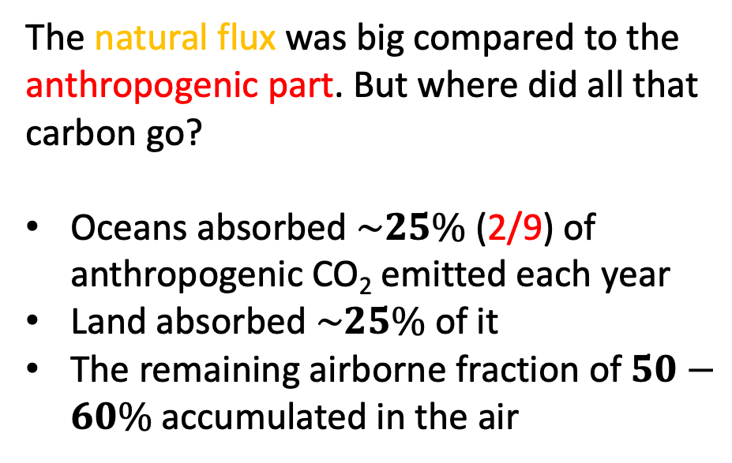
Gobal carbon fluxes
Global carbon fluxes, year 2003
The natural flux was big compared to the anthropogenic part. But where did all that carbon go?
Oceans absorbed $\sim 25\%$(2/9) of anthropogenic CO₂ emitted each year
Land absorbed $\sim 25\%$of it
The remaining airborne fraction of $50−60\%$ accumulated in the air
https://earthobservatory.nasa.gov/features/CarbonCycle
0:00 / 3:10 NASA | A Year in the Life of Earth's CO2

